Slide 1
Population Health Modeling: Day 4

Slide 2
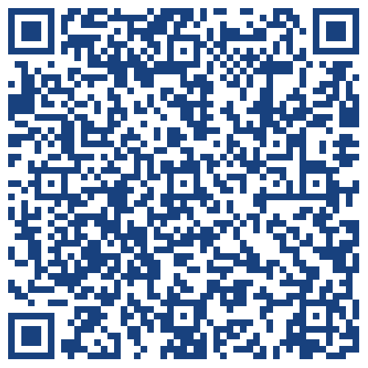
Check-In

Slide 3
Brief Review
Basic philosophical and ethical principles for public health research and public health modeling
Outbreak Investigations- lots of moving parts in any data collection/analysis process

Slide 4
Brief Overview
Info dump: Streptococcus pneumoniae
Info dump: pneumococcal vaccines
Info smattering: infectious disease surveillance
Small LARP?
Time series analysis: background and walkthrough
Time series analysis: designing a research question and modifying code
Time series analysis: data viz, prepare presentation and poster materials

Slide 5
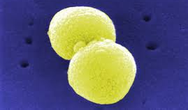
Are you a good witch or a bad witch?
Notes:
Aerobe or anaerobe? Yes
Commensal or pathogen? Yes
Old people or children? Yes
Susceptible or MDR? Yes

Slide 6
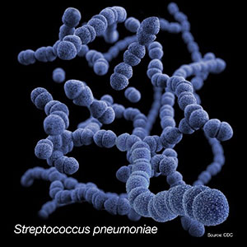
Invasive pneumococcal infections
death
invasive disease
non-invasive disease
asymptomatic carriage

Slide 7
Invasive pneumococcal infections
death
invasive disease
non-invasive disease
asymptomatic carriage

Slide 8
Invasive pneumococcal infections
death
invasive disease
non-invasive disease
asymptomatic carriage

Slide 9
Invasive pneumococcal infections
death
invasive disease
non-invasive disease
asymptomatic carriage

Slide 10
Invasive pneumococcal infections
death
environment
invasive disease
non-invasive disease
host
pathogen
asymptomatic carriage

Slide 11
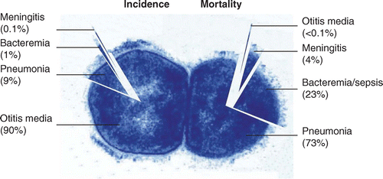

Slide 12
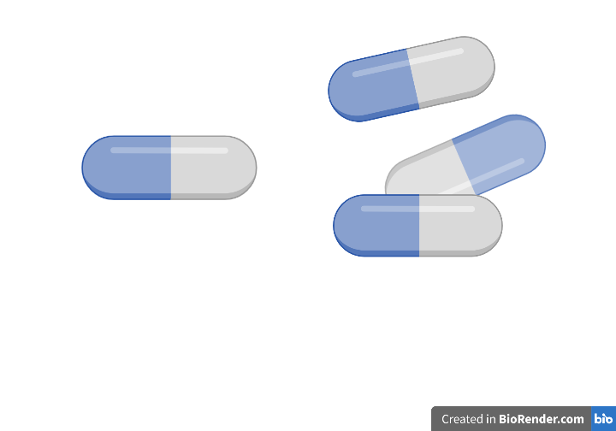
Antibiotic Therapy

Slide 13
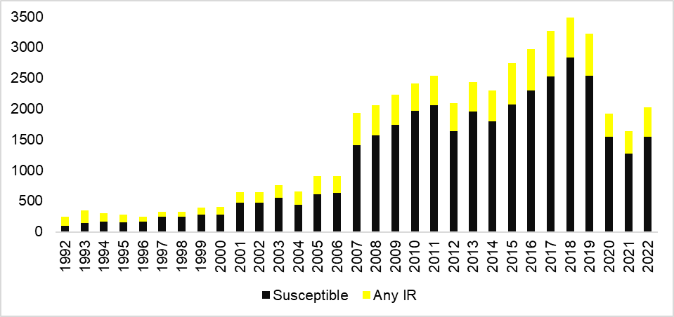
Number of isolates classified as intermediate or resistant to AT LEAST ONE antibiotic class

Slide 14
Streptococcus pneumoniae Basic Fact Sheet
Gram positive, spherical, paired bacteria that commonly colonizes the nasopharyngeal tract.
Pneumococcal disease occurs when bacteria in the nasopharyngeal tract move on to other spaces in the body.
Pneumococcal disease is a major cause of morbidity and mortality worldwide, with 14.5 million cases and 826,000 deaths.
Burden of disease is highest in the very young and the very old, especially in settings with limited resources.

Slide 15
Pneumococcal Serotypes,
Pneumococcal Vaccines,

Slide 16


Slide 17


Slide 18


Slide 20
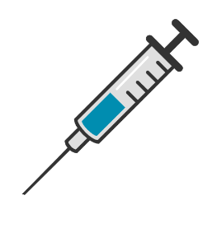
Pneumococcal Conjugate Vaccines
First in use in the US in 2000
Given to infants
Targeting the pneumos most common in severe disease

Slide 21
PCV serotypes in Invasive Pneumococcal Disease in Germany, 1992-2019

Slide 23


Slide 25


Slide 26


Slide 27
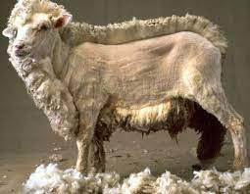

Slide 28
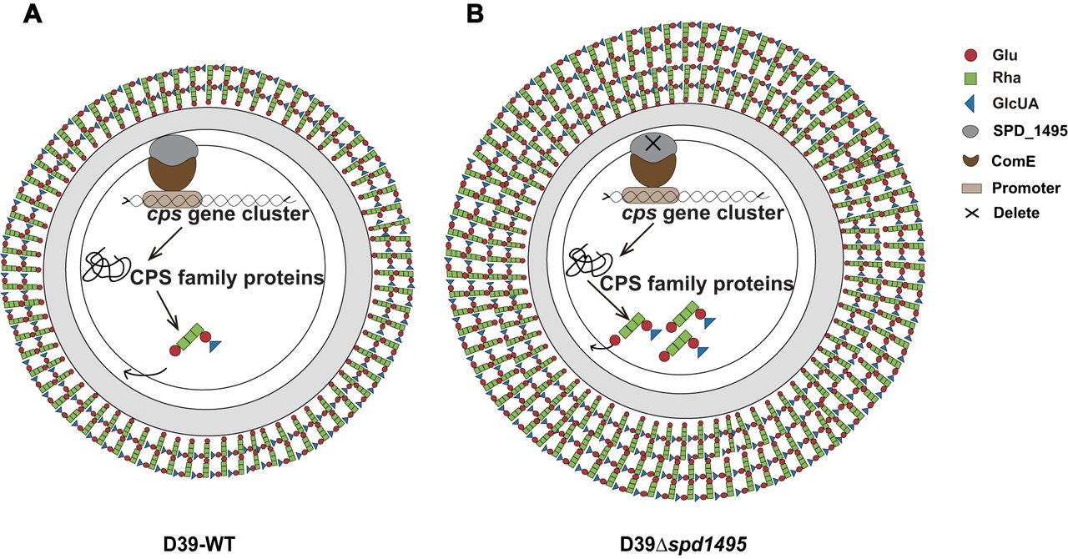
Zheng et al. SPD_1495 Contributes to Capsular Polysaccharide Synthesis and Virulence in Streptococcus pneumoniae. mSystems5:10.1128/msystems.00025-20.

Slide 30

7

Slide 31
PCV serotypes in Invasive Pneumococcal Disease in Germany, 1992-2019

Slide 33
New PCV serotypes in Invasive Pneumococcal Disease, Germany, 1992-2019

Slide 34
New PCV serotypes in Invasive Pneumococcal Disease, Germany, 1992-2019

Slide 35
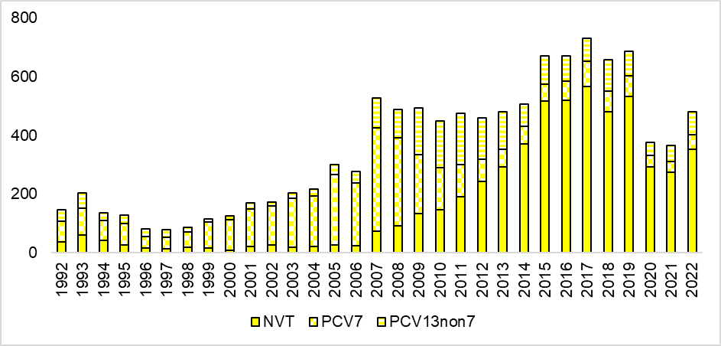
Number of isolates classified as intermediate or resistant to ANY antibiotic class, by vaccine serotype group

Slide 36


Slide 37


Slide 38
New-New vaccine serotypes in Invasive Pneumococcal Disease in Germany, 1992-2019

Slide 39
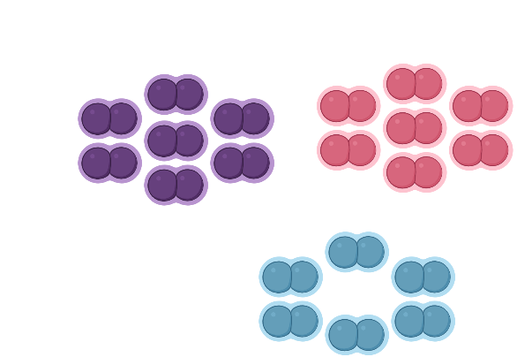
15A
24F
11A
18C
10A
12F
9V
19F
35B
8
14
33F
15B
6B
23F
28F
22F
4
16F
5
38
1
7F
9A
3
19A
6A
10B

Slide 40
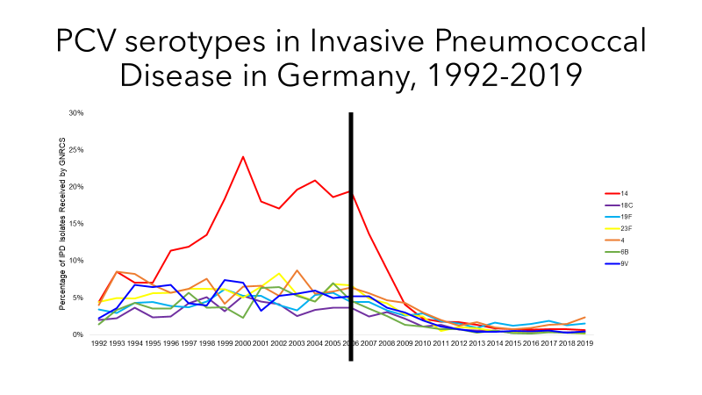
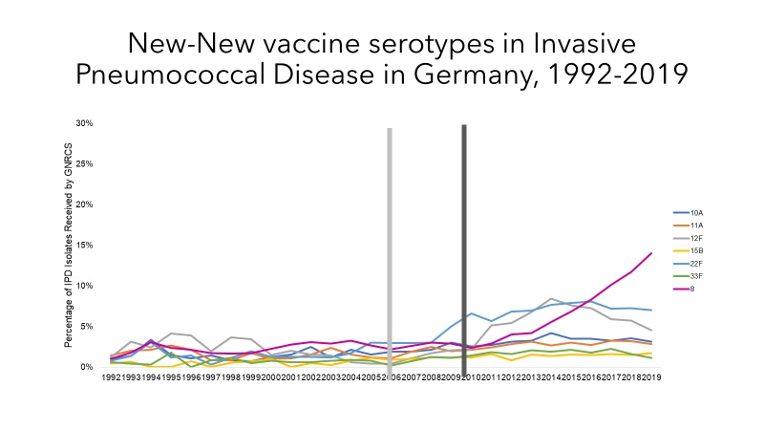
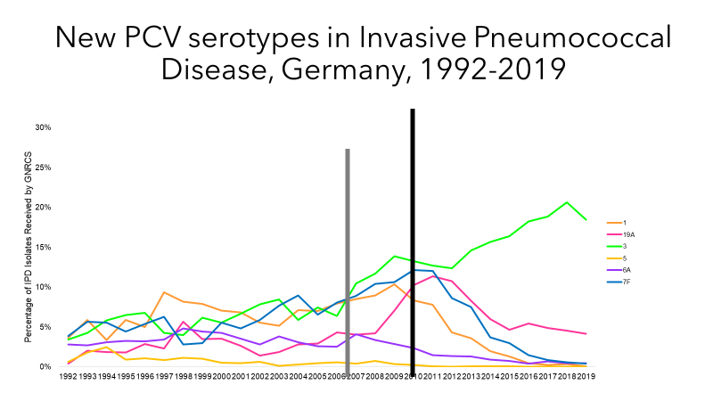
BAM
BAM
BAM

Slide 41
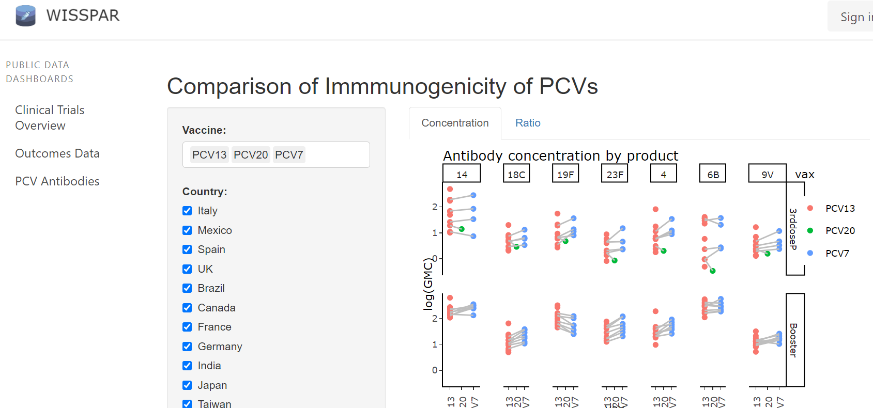
Worldwide Index of Serotype Specific Pneumococcal Antibody Responses

Slide 42
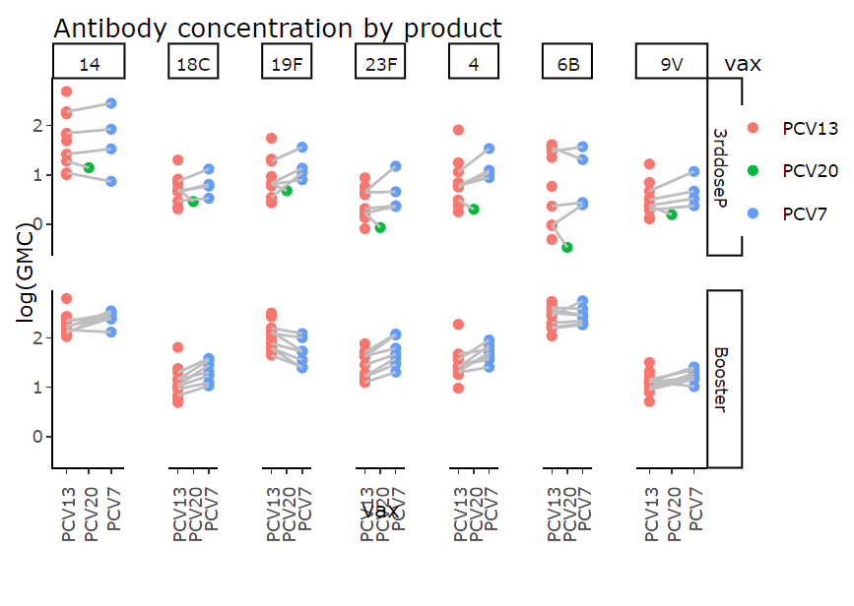

Slide 43
Viruses and Pneumococci
Flu
RSV
SARS-CoV-2

Slide 44
What happened to IPD in 2020?
Data from Nationally Notifiable Disease Surveillance System (NNDSS), data.cdc.gov

Slide 45
What happened to IPD in 2021?
Data from Nationally Notifiable Disease Surveillance System (NNDSS), data.cdc.gov

Slide 46
But Why?
Artefactual
Clinical System Overtaxed
Surveillance System Overtaxed
Actual
Changing Dynamics of Respiratory Pathogens
Nonpharmaceutical interventions

Slide 47
Artefactual
Clinical Systems
Point of Care
Medical Laboratories
Surveillance Systems
Health Departments
Federal Agencies

Slide 48
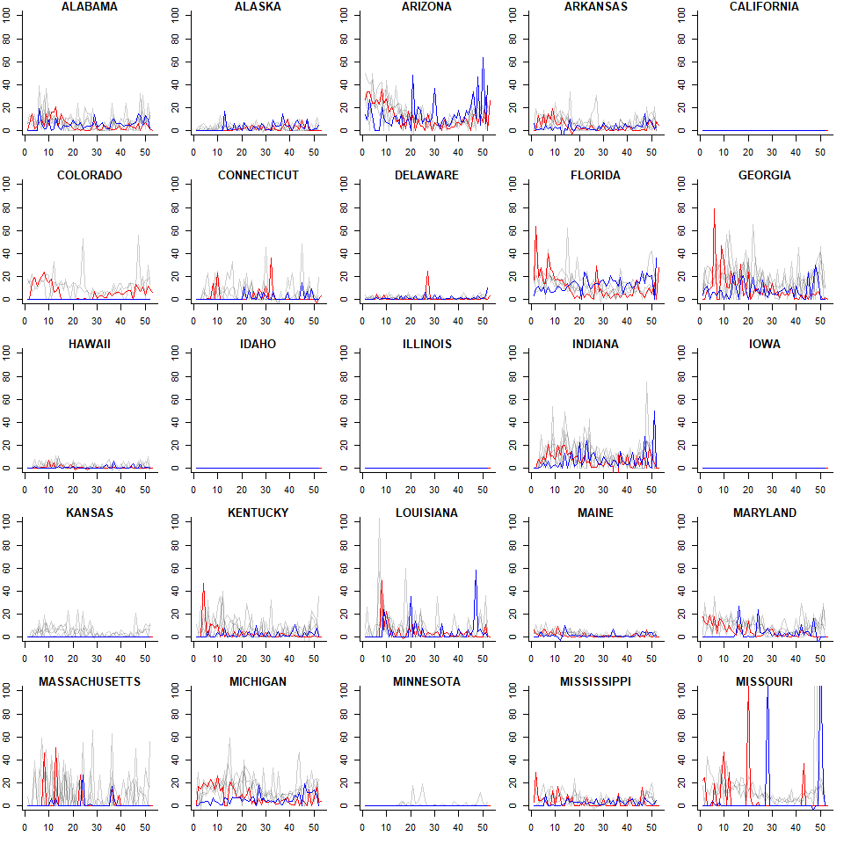
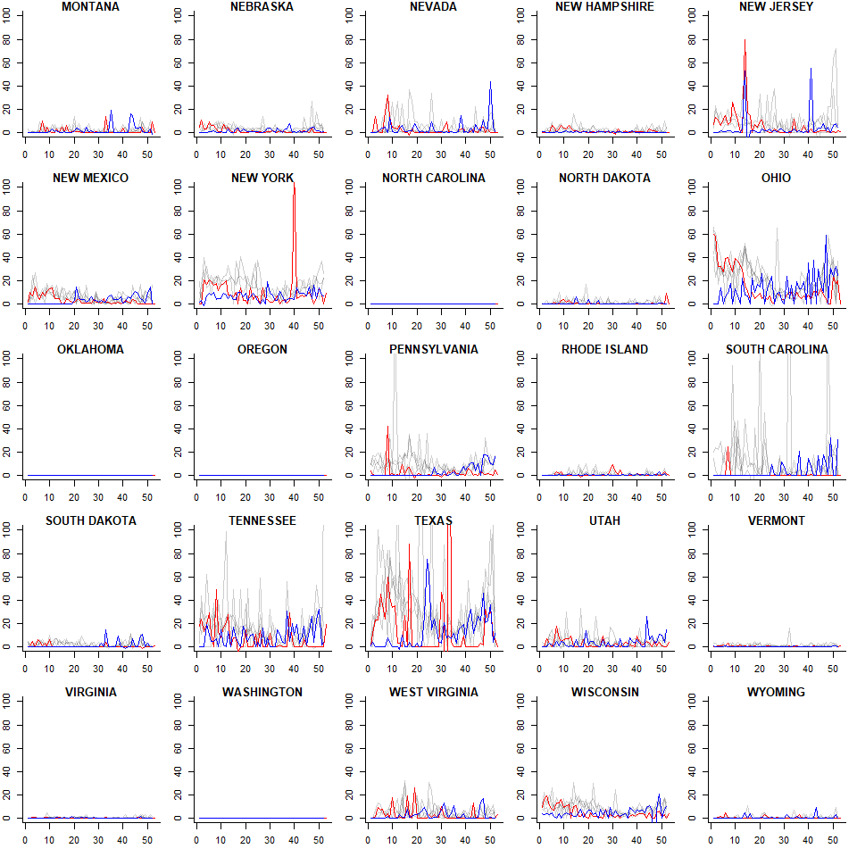
NNDSS IPD, 2016-2021
2016-2019
2020
2021

Slide 49
NNDSS IPD, change from baseline

Slide 50
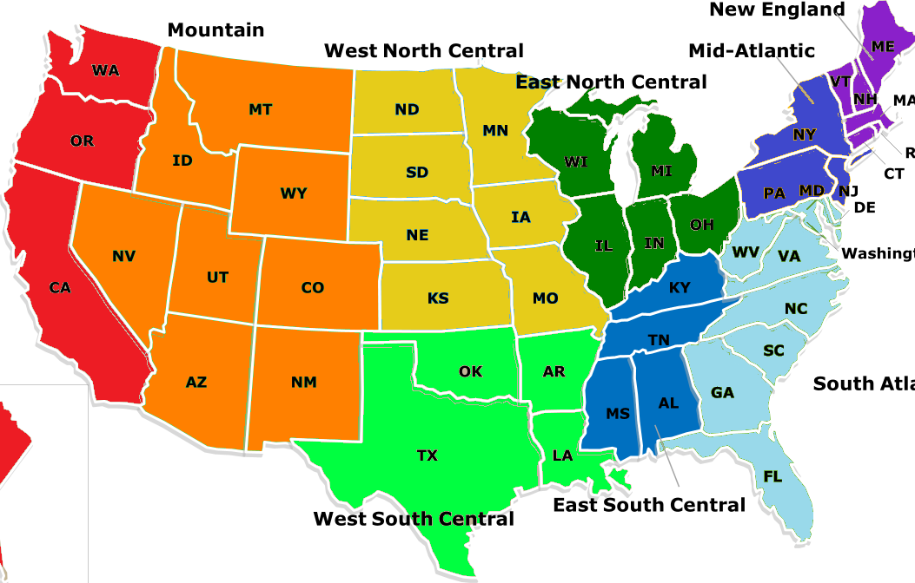
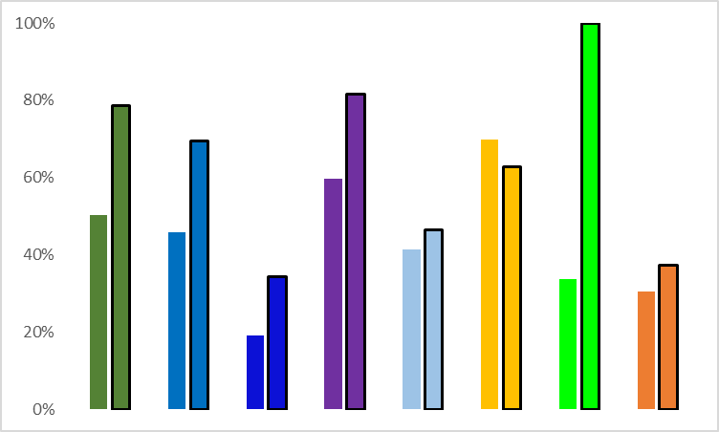
Reporting Delays, 2020
Percentage of weeks with reporting delays
2016-
2019
2020
2016-
2019
2020
2016-
2019
2020
2016-
2019
2020
2016-
2019
2020
2016-
2019
2020
2016-
2019
2016-
2019
2020
2020

Slide 51
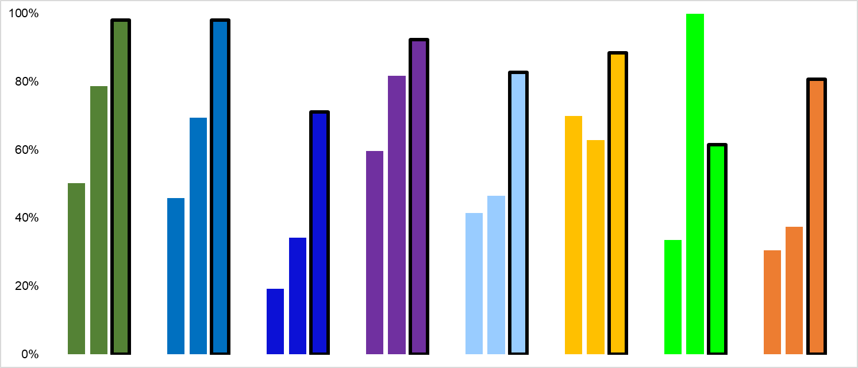
Reporting Delays, 2021
Percentage of weeks with reporting delays
‘16-
‘19
‘20 ‘21
‘16-
‘19
‘20 ‘21
‘16-
‘19
‘20 ‘21
‘16-
‘19
‘20 ‘21
‘16-
‘19
‘20 ‘21
‘16-
‘19
‘20 ‘21
‘16-
‘19
‘20 ‘21
‘16-
‘19
‘20 ‘21

Slide 52
Actual
Changing dynamics of respiratory pathogens
Nonpharmaceutical interventions

Slide 53
United States Mobility, Overall
% decrease, work
% decrease, transit
% decrease, retail
% decrease, IPD
stringency index
% decrease from baseline

Slide 54
US Mobility, State Level
% decrease, work
% decrease, transit
% decrease, retail
% decrease, IPD
stringency index

Slide 55
But Why?
Artefactual
Clinical System Overtaxed
Surveillance System Overtaxed
Actual
Changing Dynamics of Respiratory Pathogens
Nonpharmaceutical interventions

Slide 56
Pneumococcal Serotype Replacement

Slide 57
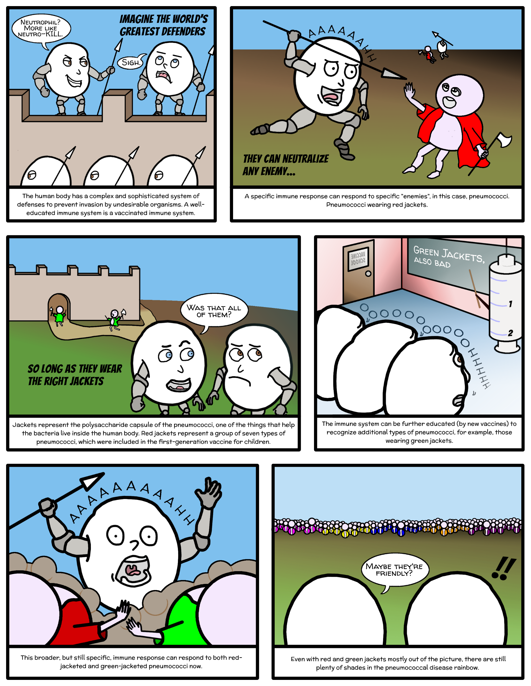

Slide 63
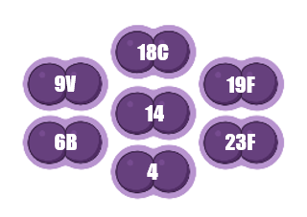

Slide 64
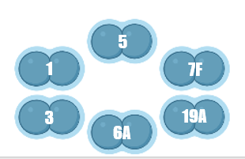

Slide 65
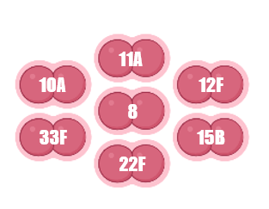

Slide 66
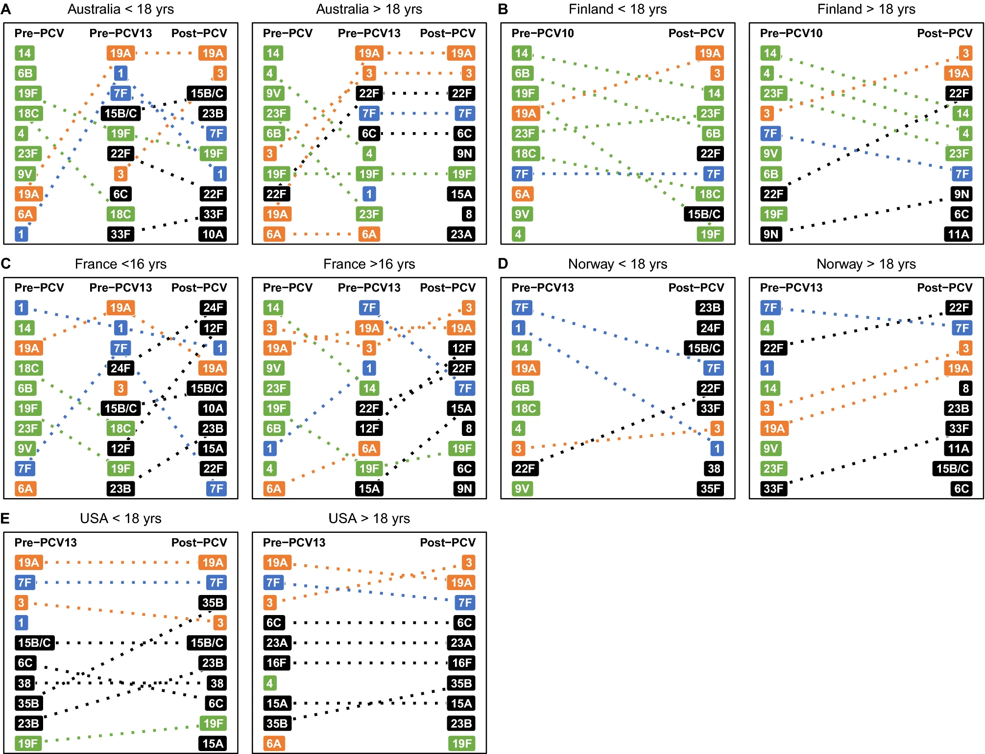
Serotype Replacement Differences by Age

Slide 67
Serotype Replacement Differences by Age

Slide 68
Serotype Replacement Differences by Age

Slide 69
Serotype Replacement Differences by Age

Slide 70
Serotype Replacement Differences by Age

Slide 71
Example: Surveillance of non-Invasive Pneumococcal Pneumonia (SnIPP)

Slide 72
Why pneumococcal pneumonia?
#
$

Slide 73

Death
Invasive
Pneumococcal
Disease
Non-invasive Disease

Slide 74
Clinical Presentations: IPD
Invasive Pneumococcal Disease
bacteria isolated from a normally sterile site within the body
blood
cerebrospinal fluid
synovial fluid
Severe, high mortality illnesses
meningitis
sepsis
bacteremic pneumonia

Slide 75
Surveillance of IPD
109 countries have an IPD surveillance system
IPD is hard to miss, but not impossible

Slide 76
Clinical Presentation: NIPD
Non-invasive Pneumococcal Disease
bacteria overgrow and infect tissue, causing disease
Middle ear fluid
Sputum
Urine
Less severe, but can be clinically serious and can lead to IPD and death
HUGE burden of disease
Hospitalizations
Primary care visits
Antibiotic use

Slide 77

Surveillance of Non-invasive Disease
Patchy, syndromic
Etiology of NIPDs not often ascertained
Treat empirically
Sample collection issues
NIPDs are easy to miss
But if missed
underestimated burden of disease
underestimate cost-effectiveness of vaccines

Slide 78
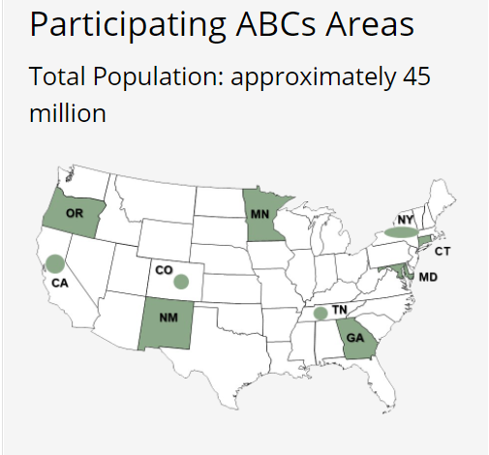


Surveillance System Participants

Slide 79
Surveillance System Participants
Physician/APRN- clinical suspicion of pneumonia, trust in PUAT
Clin Micro Lab- timely result, sufficient sample volume
CT DPH staff- receive faxes of Case Report Forms
Yale EIP personnel- verify cases and submit them to CDC
CDC- use compiled case data for analyses and to inform recommendations for pneumococcal vaccine policy

Slide 80


Surveillance System Technology

Slide 81
So Why Bother?

Slide 82
Why pneumococcal pneumonia?
#
$

Slide 83
Pneumococcal Vaccines
Costs of IPD + NIPD warrant costs of vaccines
Costs of vaccines are high
Pneumococcal vaccines were in use in 145 countries (as of 2020)
Vaccines are highly effective at protecting against included serotypes
Other serotypes rise in prevalence and replace vaccine serotypes

Slide 84
CT SNiPP goals
Contribute to national analyses of non-invasive pneumococcal pneumonia trends
Inform adult vaccine recommendations
Save money, improve clinical management, reduce antibiotic use, etc.

Slide 85
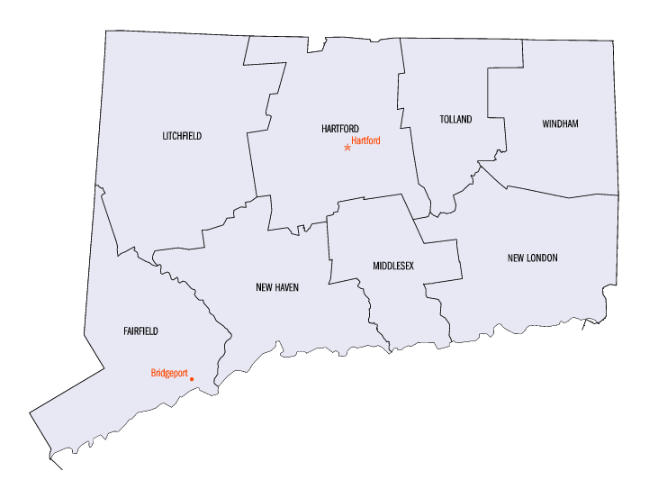


CDC→ ABC →CT SNiPP

Slide 86
SNiPP
Surveillance of Non-invasive Pneumococcal Pneumonia
How to count SNiPP cases?
Does a case get identified?
Does a case reported?
Does a case get verified?

Slide 87
SNiPP
Surveillance of Non-invasive Pneumococcal Pneumonia
Does a case get identified?
Decision point hub 0: Patients
Access to care
PCP vs ED

Slide 88
SNiPP
Surveillance of Non-invasive Pneumococcal Pneumonia
Does a case get identified?
Decision point hub 1: Point of care
Clinical suspicion (EMR)
PUAT
CXR or CT

Slide 89



SNiPP
Surveillance of Non-invasive Pneumococcal Pneumonia
Does a case get reported?
Decision point hub 2: Lab to Lab
Clinical microbiology
Administrative staff
System compatibility

Slide 90
SNiPP
Surveillance of Non-invasive Pneumococcal Pneumonia
Does a case get verified?
Decision Point hub 3: Data Quality
System compatibility
Inclusion/exclusion criteria

Slide 91
SNiPP
Surveillance of Non-invasive Pneumococcal Pneumonia
Inclusion/Exclusion Criteria
Has pneumococcal pneumonia
Positive UAT
Clinically confirmed inpatient pneumonia
Is ≥18 years old
Resident of New Haven County or Resident of Fairfield County
Non-invasive disease
No prior hospitalization for pneumococcal pneumonia within 30 days

Slide 92
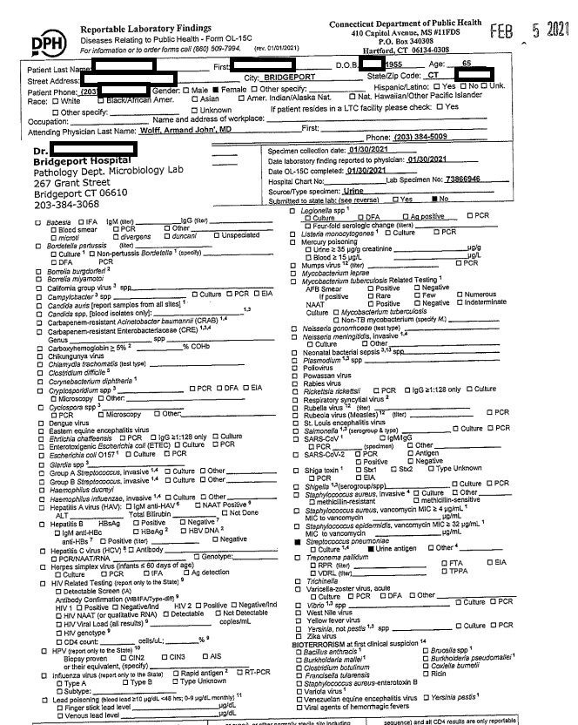
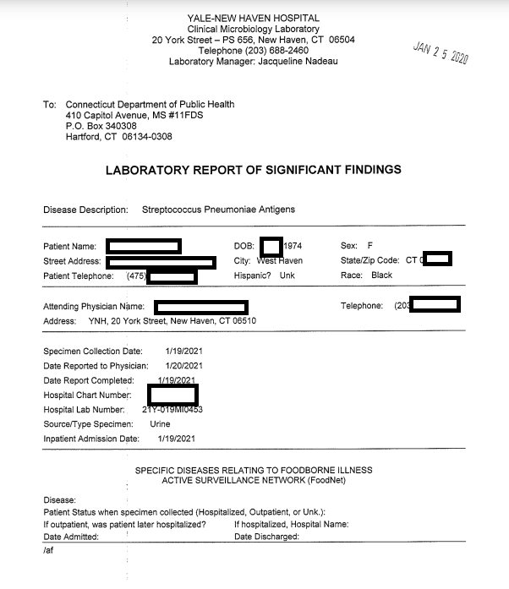
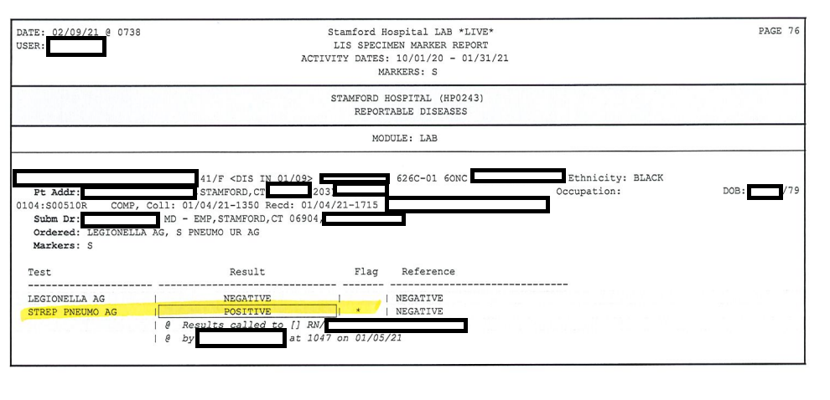
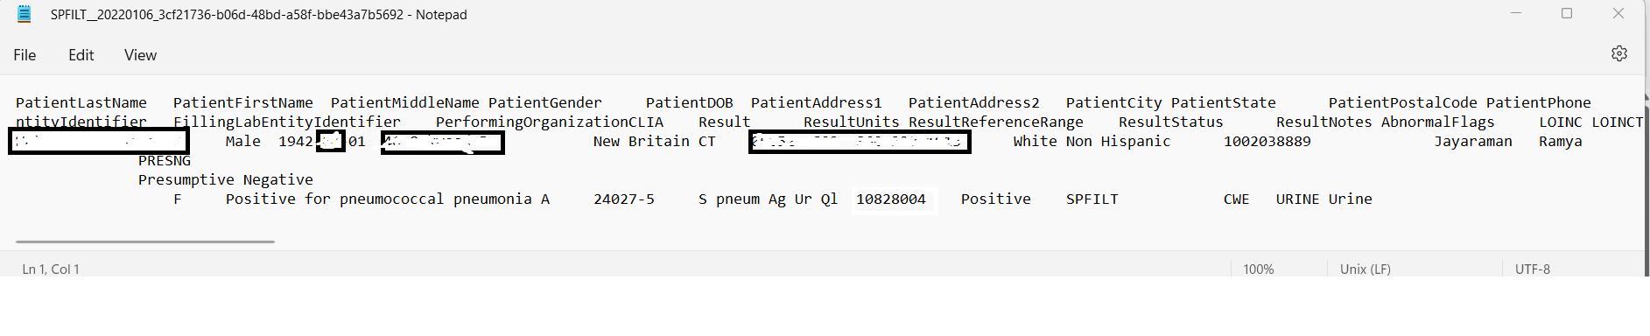
SNiPP
Surveillance of Non-invasive Pneumococcal Pneumonia
Dph reports

Slide 93
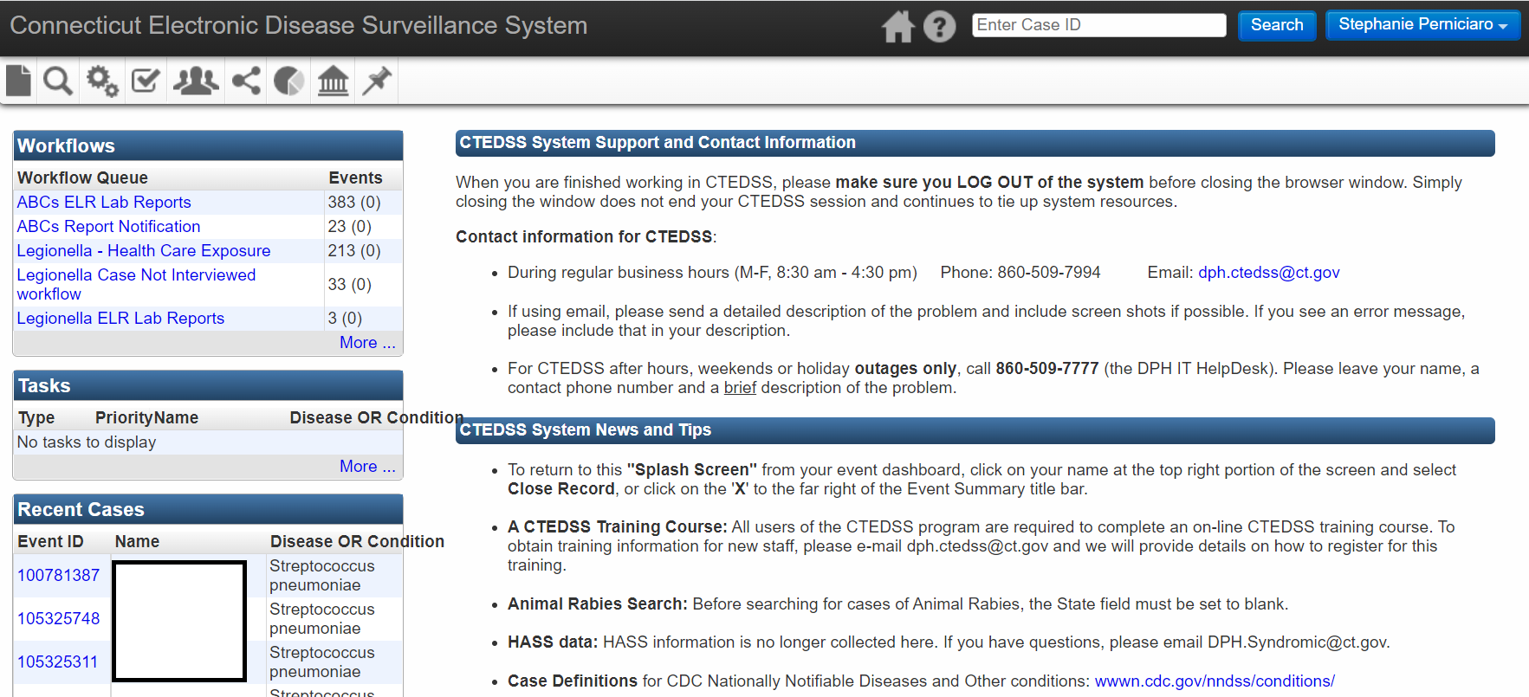
SNiPP
Surveillance of Non-invasive Pneumococcal Pneumonia
.

Slide 94
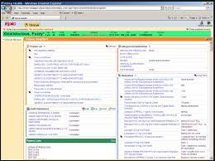
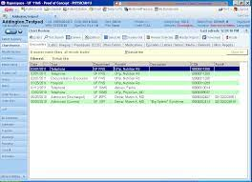
SNiPP
Surveillance of Non-invasive Pneumococcal Pneumonia

Slide 95
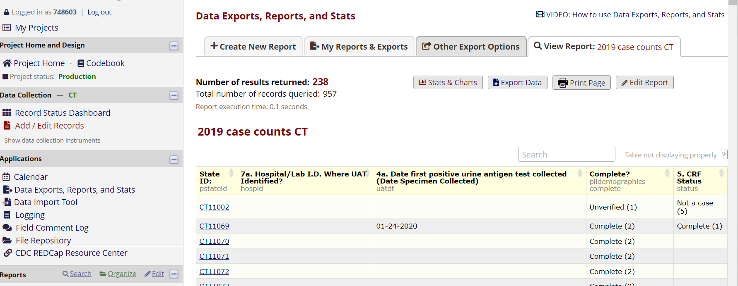
SNiPP
Surveillance of Non-invasive Pneumococcal Pneumonia

Slide 96
Your Turn

Slide 97
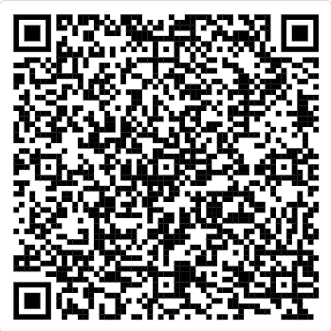
LARP

Slide 98
CT SNiPP goals
Contribute to national analyses of non-invasive pneumococcal pneumonia trends
Inform adult vaccine recommendations
Save money, improve clinical management, reduce antibiotic use, etc.

Slide 99
Preview
Time series analysis!

Slide 100
Pneumococcal Diagnostics

Slide 101

How do we find IPD?

Slide 102
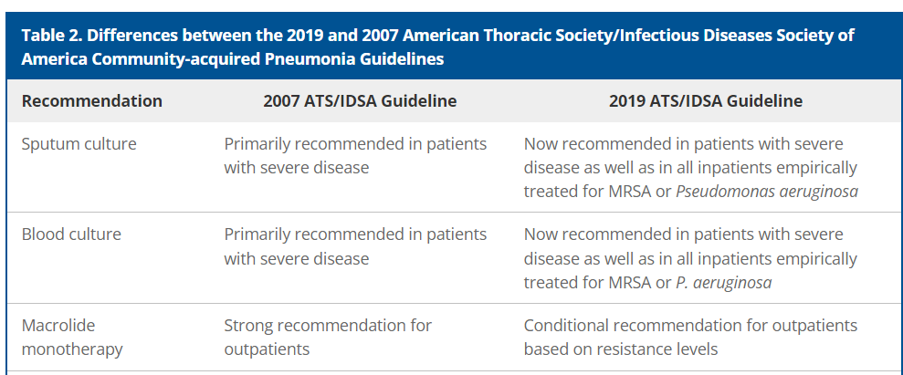
Blood culture guidelines for CAP

Slide 103
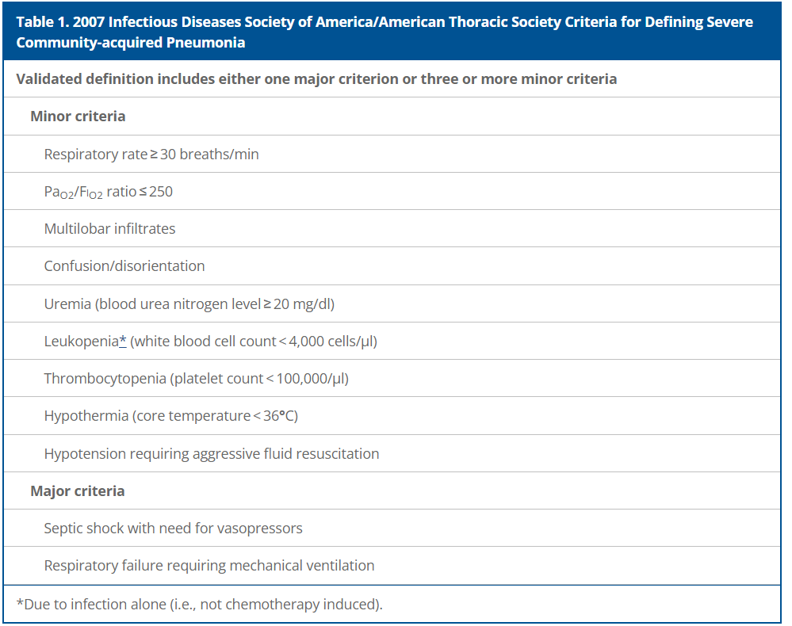
Criteria for severe CAP

Slide 104
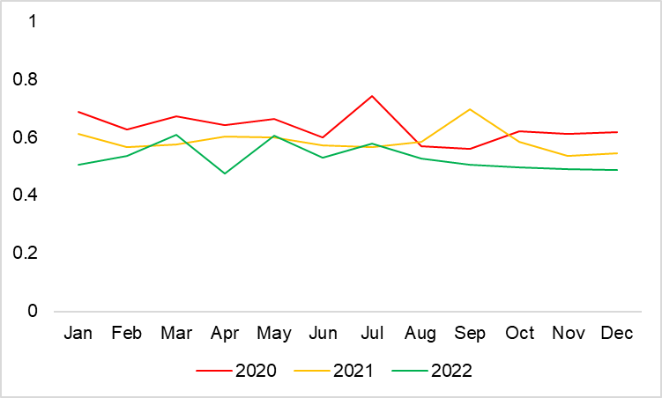
YNHH Admissions with a primary diagnosis of pneumonia, proportion of cases with blood culture

Slide 105
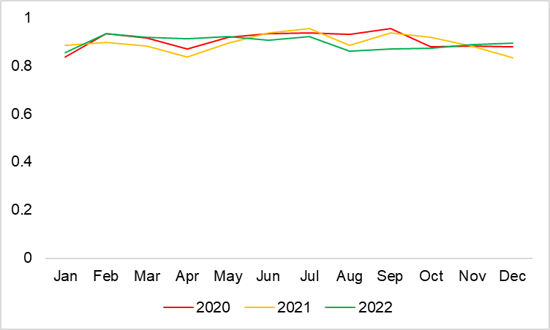
YNHH Admissions with a primary diagnosis of sepsis, proportion of cases with blood culture

